Slide 1

RN SHETTY TRUST®
RNS INSTITUTE OF TECHNOLOGY
Autonomous Institution Affiliated to VTU, Recognized by GOK, Approved by AICTE
(NAAC ‘A+ Grade’ Accredited, NBA Accredited (UG - CSE, ECE, ISE, EIE and EEE)
Channasandra, Dr. Vishnuvardhan Road, Bengaluru - 560 098
Ph:(080)28611880,28611881 URL: www.rnsit.ac.in
Data structures Laboratory-BCSL305
Social Networking
Staff in Charge: Dr. Sunitha K
Designation: Assistant Professor
Carried out by:
Chetan N Joshi (1RN22IS029)
Hemanth T (1RN22IS050)
Moksh A N (1RN22IS191)

Slide 2
CONTENTS
Abstract
Introduction
Objective
Data structures
Project flowchart
Implementation modules
Results
Conclusion
Future Enhancements
References
Department of ISE,RNSIT

Slide 3
Abstract
Optimizing Data Structures: This presentation explores the utilization of linked lists in the context of social networking platforms, emphasizing the efficiency and flexibility they offer for managing connections and user data.
Scalable Social Connectivity: By employing linked lists, social networks can efficiently handle dynamic relationships, facilitating the addition and removal of connections without significant performance overhead.
Performance Analysis and Enhancement: We delve into the performance considerations of linked lists, discussing strategies for optimizing operations and addressing scalability challenges as social networks expand.
Department of ISE,RNSIT

Slide 4
Introduction
In the age of digital connectedness, social networking platforms have become an essential part of our everyday lives, changing the way we interact, exchange information, and connect with others.
As the demand for fast and scalable social networking systems grows, Data Structures and Algorithms (DSA) play an increasingly important role in developing robust and feature-rich platforms.
Our research focuses on developing a Social Networking System with Linked Lists, a basic data structure in computer science.
Linked Lists offer a dynamic and flexible approach to organise and handle data, making them an excellent choice for modelling user relationships, postings, and interactions in a social network.
Department of ISE,RNSIT

Slide 5
Objective of the project
Demonstrate the utility of linked lists in social network development.
Illustrate how linked lists efficiently manage user connections and data.
Provide insights into the implementation of basic social networking features using linked lists, emphasizing simplicity and scalability.
Department of ISE,RNSIT

Slide 6
Data Structure - Linked list
Linked list is a linear data structure consisting of nodes where each node points to the next node in the sequence. In social networking, linked lists are useful for:
Efficiently managing user connections and friend lists.
Facilitating dynamic updates such as adding or removing friends.
Optimizing memory usage by allocating space as needed for varying numbers of connections.
Department of ISE,RNSIT

Slide 7
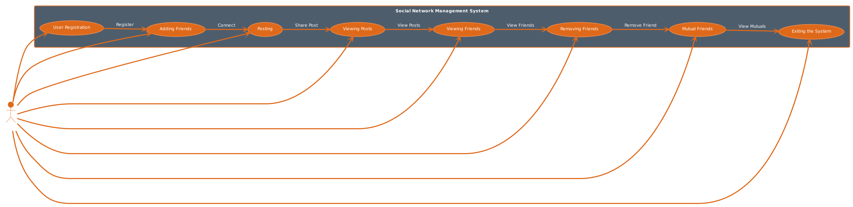
Project flowchart
Department of ISE,RNSIT

Slide 8
Implementation modules
stdio header file
stdlib header file
string header file
Department of ISE,RNSIT

Slide 9
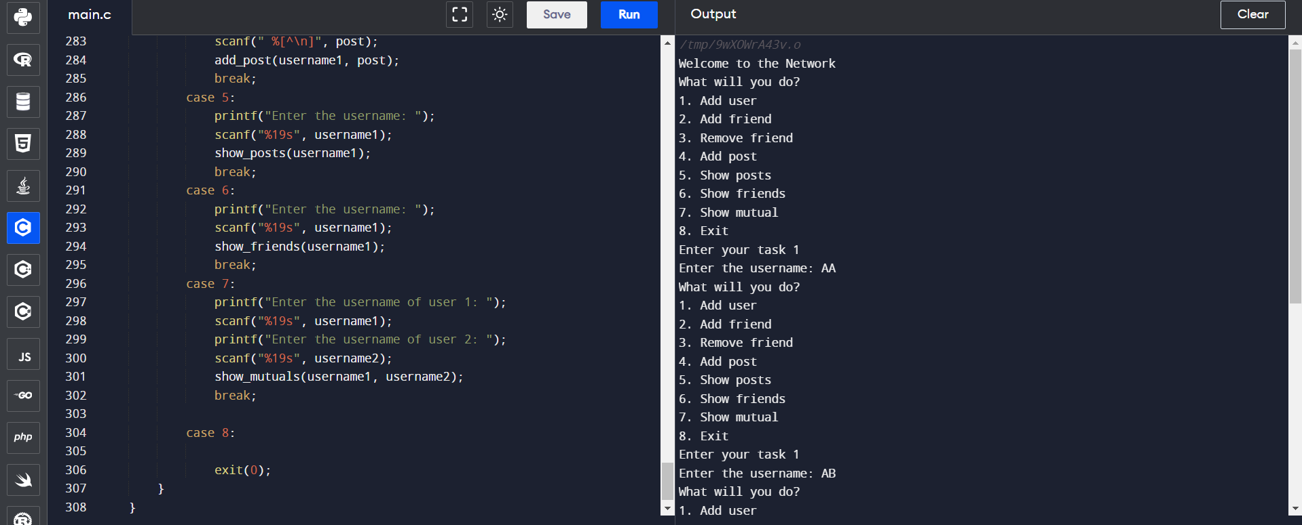
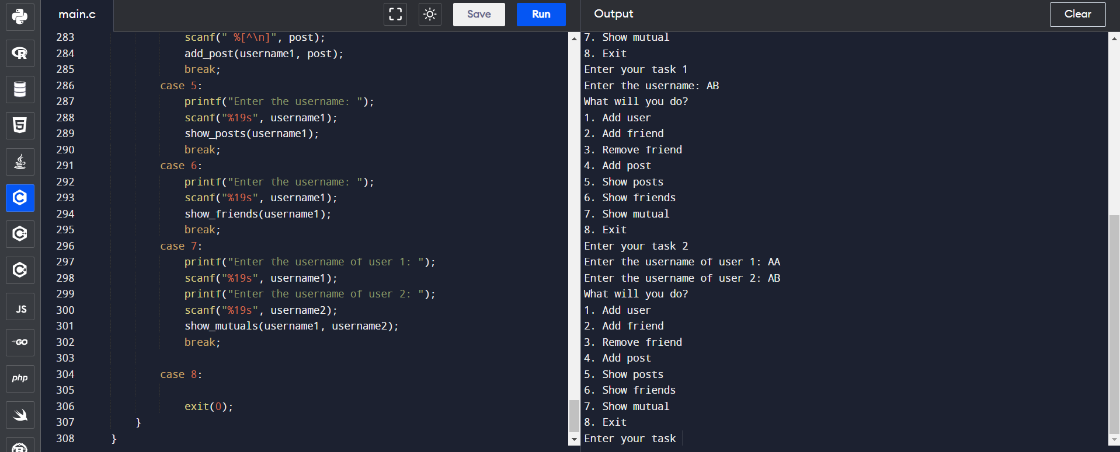
Results
Department of ISE,RNSIT

Slide 10
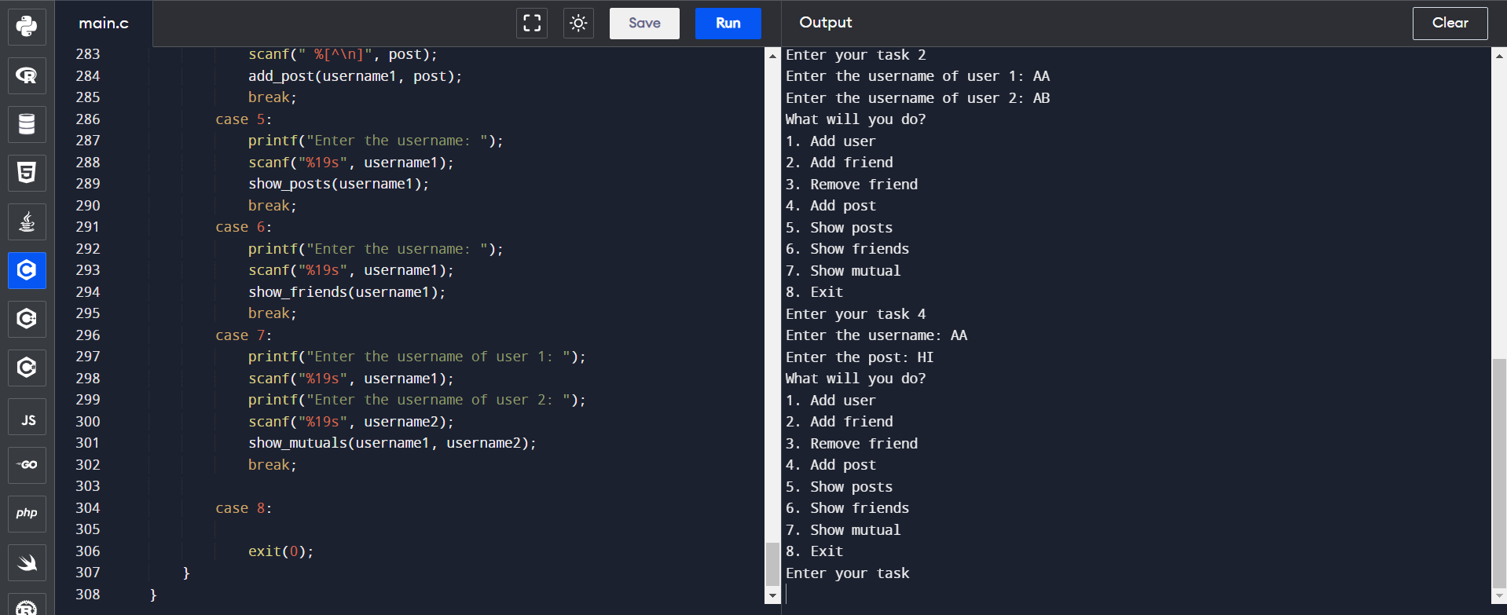
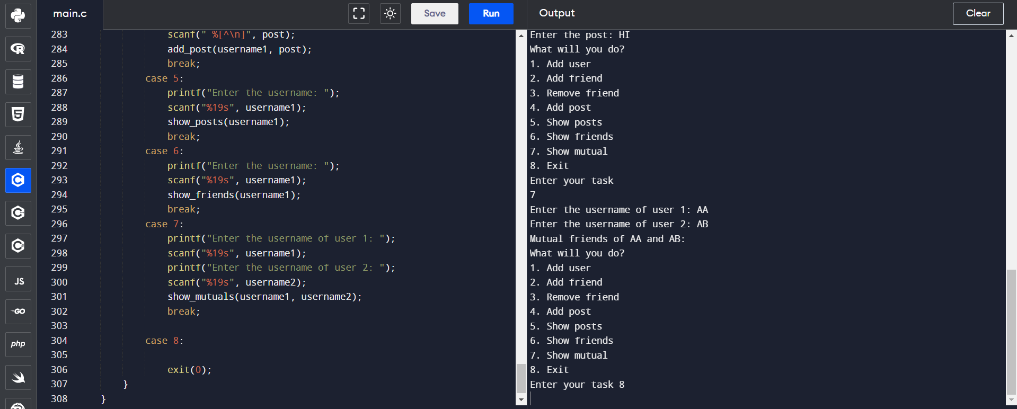

Slide 11
Conclusion
Linked lists offer a flexible and efficient way to manage connections and user data in social networks, facilitating quick access and modification operations.
Despite their simplicity, linked lists can scale effectively with growing networks, providing a foundation for future expansion and adaptation to changing user needs.
By leveraging the strengths of linked lists, social networking platforms can achieve optimized performance, ensuring smooth user experiences and seamless interactions.
Department of ISE,RNSIT

Slide 12
Future enhancements
1. *Integration of Hash Tables for Faster Search*: Implement hash tables to optimize search operations, such as finding connections or user profiles, for improved performance.
2. *Implementation of Graph Data Structures*: Integrate graph data structures to represent more complex relationships beyond simple friendships, such as group memberships, follower-followee relationships, or hierarchical connections.
3. *Incorporation of Machine Learning Algorithms*: Utilize machine learning algorithms to analyze user behavior, preferences, and interactions, enabling personalized content recommendations, targeted advertisements, or sentiment analysis.
4. *Enhanced Security Features*: Implement robust security measures, such as encryption techniques, access controls, and anomaly detection algorithms, to protect user data and prevent unauthorized access or malicious activities.
These future enhancements can contribute to the continuous improvement and evolution of the social networking application, making it more versatile, engaging,
Department of ISE,RNSIT

Slide 13
References
https://www.geeksforgeeks.org/
https://www.github.com
https://code-projects.org/

Slide 14
THANK YOU
Department of ISE,RNSIT

